Slide 1
UNIVERSITY INSTITUTE OF COMPUTING
Master of Computer Applications
Minor Project
22CAR-707
Kann: Connecting Restaurants And Hungry Souls
Student Name: Chirag, Rishav Kumar
UID: 22MCC20068, 22MCC20039
Section/Group: 22MCD-1 (A)
Supervisor Name: Ms. Amandeep Kaur
Designation: Assistant Professor
Minor Project Presentation
DISCOVER . LEARN . EMPOWER

Slide 2
Presentation Outline
Introduction
Technology Used
Objectives
Scope/Relevance
Comparative Analysis
Conclusion & Future Aspects
Bibliography

Slide 3
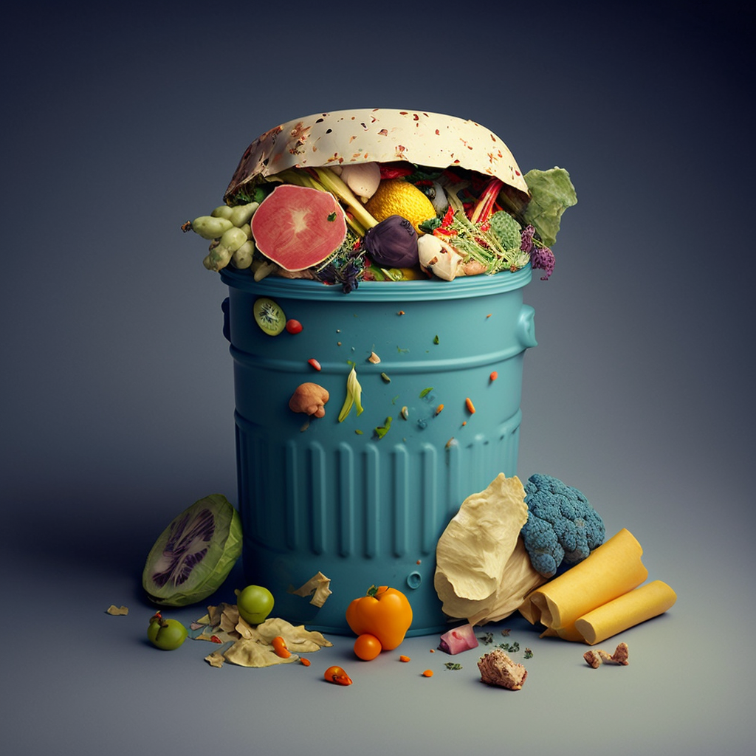
Introduction
What it is ?
"KANN" is a web application designed to address the pressing global issue of food wastage and Hunger by connecting restaurants/NGO and individuals in need. The need for KANN arises from the following factors:
Food Wastage Concerns
Environmental Sustainability
Global Hunger Issues
Inefficiencies in Current Systems
“Hunger is more than missing a meal”
*

Slide 4




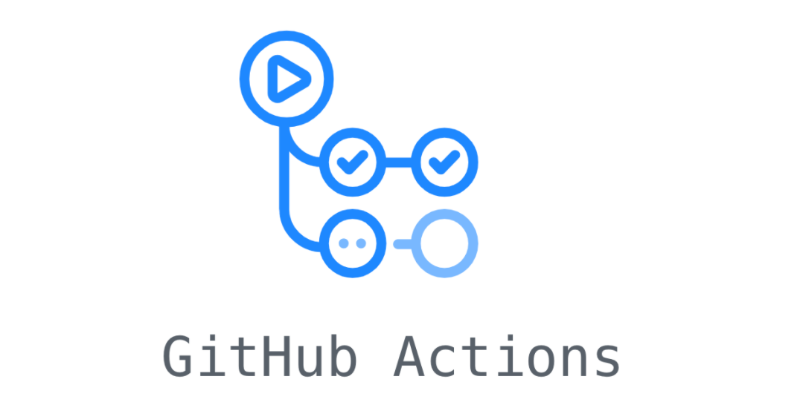

Technology Used
Node MongoDB Docker(Containerization)
*
*
*
*
Github Github Actions
*
*

Slide 5
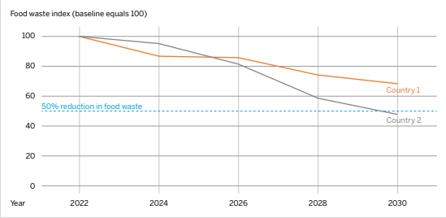
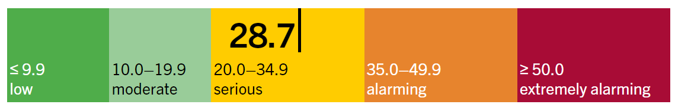
Objectives
Addressing Global Food Wastage
Providing Platform for Social Workers
Supporting Food Recovery Initiatives
Connecting Hearts, Not Just Businesses
Our objectives extend beyond mere functionality; they are the heartbeat of a revolutionary endeavor.Through KANN, we engineer solutions to address pressing global challenges, with a focus on:

Slide 6

Scope/Relevance
Corporate Social Responsibility (CSR)
Environmental Conservation
Efficiency in Food Distribution
Cost-Effective Social Impact
Adaptability and Scalability
KANN's scope and relevance extend across various domains, embodying a transformative impact on societal and environmental fronts. Its broad scope encompasses:

Slide 7

Comparative Analysis
In the pursuit of excellence and informed decision-making, a comparative analysis stands as a beacon, guiding us through the labyrinth of choices. This critical evaluation method serves as a compass, allowing us to dissect and compare various alternatives, solutions, or systems against a set of predefined criteria.
Ease of Transition of Business: Facilitates a smooth transition for businesses from food wastage to food donation.
Support for Charities: Provides a cost-effective solution for businesses to contribute to social causes.
Scalability: Can handle increased demand for food donation services
Kann Platform Logo

Slide 8

Conclusion And Future Aspects
Improving Platform functionality
Address wider TAM
Inventory Management
Volunteer Management System
New Program Initiatives
There are number of things that should be implemented in future to achieve goal of our project:
*[6] Unsplash

Slide 9
Bibliography
* [1] : Google Images
https://images.google.com/
[2] :UNEP Food Waste Index Report
https://www.unep.org/resources/report/unep-food-waste-index-report-2021
[3]: Food Waste in India
https://www.chintan-india.org/sites/default/files/2019-09/Food%20waste%20in%20India.pdf
[4] Global Hunger Index
https://www.globalhungerindex.org/india.html
[5] Unsplash. (n.d.). Beautiful free Images & Pictures | Unsplash. Unsplash
https://unsplash.com/ [6] UNEP Food Waste Index Report 2021.

Slide 10
THANK YOU

